Slide 1
Architectural Styles

Slide 2
Architectural Styles
Architecture styles, sometimes called architecture patterns, describe a named relationship of components covering a variety of architecture characteristics.
An architecture style is the overarching structure of how the user interface and backend source code are organized (such as within layers of a monolithic deployment or separately deployed services) and how that source code interacts with a datastore.
Architecture patterns, on the other hand, are lower-level design structures that help form specific solutions within an architecture style (such as how to achieve high scalability or high performance within a set of operations or between sets of services).
An architecture style describes the topology, assumed and default architecture characteristics, both beneficial and detrimental.
@Dr. Ugrasen Suman, Professor, SCSIT, DAVV Indore (MP), India

Slide 3
Big Ball of Mud
Architecture styles, sometimes called architecture patterns, describe a named relationship of components covering a variety of architecture characteristics.
An architecture style is the overarching structure of how the user interface and backend source code are organized (such as within layers of a monolithic deployment or separately deployed services) and how that source code interacts with a datastore.
Architecture patterns, on the other hand, are lower-level design structures that help form specific solutions within an architecture style (such as how to achieve high scalability or high performance within a set of operations or between sets of services).
An architecture style describes the topology, assumed and default architecture characteristics, both beneficial and detrimental.
@Dr. Ugrasen Suman, Professor, SCSIT, DAVV Indore (MP), India

Slide 4

Big Ball of Mud
In general, architects want to avoid this type of architecture at all costs.
The lack of structure makes change increasingly difficult and also suffers from problems in deployment, testability, scalability, and performance.
Such architecture anti-pattern
occurs quite commonly in the
Real world.
Few architects intend to create
one, but many projects
inadvertently manage to create
a mess because of lack of
governance around code quality and structure.
@Dr. Ugrasen Suman, Professor, SCSIT, DAVV Indore (MP), India

Slide 5
Unitary Architecture
When software originated, there was only the computer, and software ran on it.
Through the various eras of hardware and software evolution, the two started as a single entity, then split as the need for more sophisticated capabilities grew.
For example, mainframe computers started as singular systems, then gradually separated data into its own kind of system.
Similarly, when personal computers first appeared, much of the commercial development focused on single machines.
As networking PCs became common, distributed systems (such as client/ server) appeared.
Few unitary architectures exist outside embedded systems and other highly constrained environments.
Generally, software systems tend to grow in functionality over time, requiring separation of concerns to maintain operational architecture characteristics, such as performance and scale.
@Dr. Ugrasen Suman, Professor, SCSIT, DAVV Indore (MP), India

Slide 6
Monolithic Vs. Distributed Architectures
Architecture styles can be classified into two main types: monolithic (single deployment unit of all code) and distributed (multiple deployment units connected through remote access protocols)
Distributed architecture styles, while being much more powerful in terms of performance, scalability, and availability than monolithic architecture styles, have significant trade-offs for this power.
The first group of issues facing all distributed architectures are described in the fallacies of distributed computing.
A fallacy is something that is believed or assumed to be true but is not.
@Dr. Ugrasen Suman, Professor, SCSIT, DAVV Indore (MP), India

Slide 7
The fallacies of distributed computing
The Network Is Reliable
  The network is not reliable
  Latency Is Zero
  Latency is not zero
  Bandwidth Is Infinite
  Bandwidth is not infinite
  The Network Is Secure
  The network is not secure
  The Topology Never Changes
  The network topology always changes
  There Is Only One Administrator
  There are many network administrators, not just one
  Transport Cost Is Zero
  Remote access costs money
  The Network Is Homogeneous
  The network is not homogeneous
@Dr. Ugrasen Suman, Professor, SCSIT, DAVV Indore (MP), India

Slide 8
Classification of Architectural styles
Monolithic | Distributed
Layered Pipe & Filter Microkernel Data-flow Interpreter Rule-based | Client-server Shared data Event-based Service-oriented Space-based Microservices Object-oriented Mobile-code Implicit invocation Publish-subscribe Peer-to-peer, etc.

Slide 9
Layered Architectural Style
Layered style of architecture is the hierarchical organization of a system in layers.
Layered systems are designed in a modular fashion at each layer in the architecture.
There are well-defined interfaces between the layers. A layer provides service to the layer above it and acts as a client to the layer below it.
Examples: Layered organization of an operating system, a database system, an object request broker (ORB), network layers, etc.
@Dr. Ugrasen Suman, Professor, SCSIT, DAVV Indore (MP), India

Slide 10
Layered Architectural Style
Subsystem E
Subsystem F
Layer n
Subsystem C
Subsystem D
Layer 2
Subsystem A
Subsystem B
Layer 1
@Dr. Ugrasen Suman, Professor, SCSIT, DAVV Indore (MP), India

Slide 11
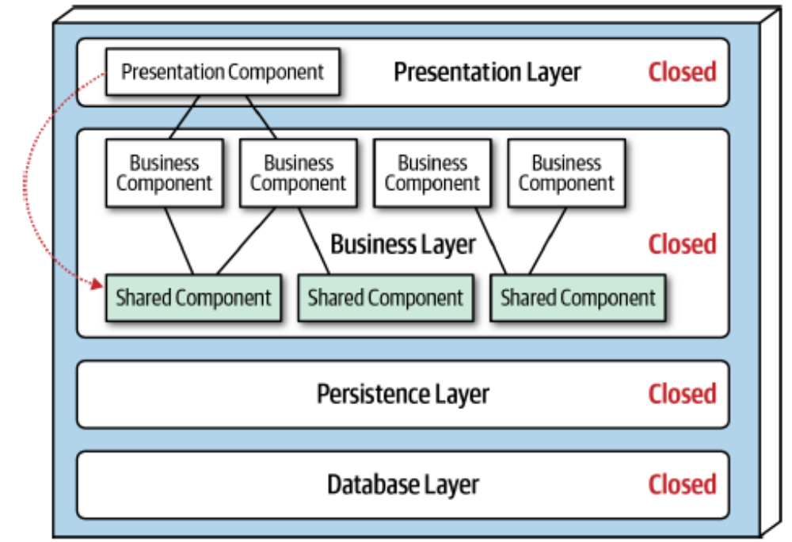
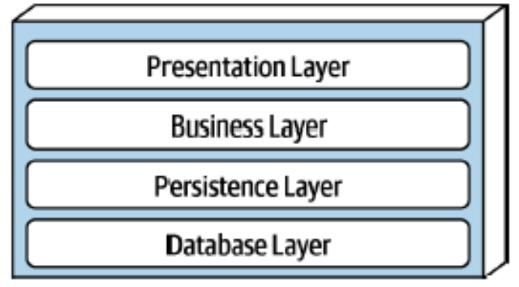
Layered Architectural Style (Standard)
@Dr. Ugrasen Suman, Professor, SCSIT, DAVV Indore (MP), India

Slide 12
Benefits and drawbacks of Layered Style
Benefits:
Using the layered style, a system is designed based on the increasing level of abstraction.
The details of unnecessary implementation can be hidden at any layer.
New features can be added to a layer and new layers can be created.
The layers can be modified without affecting the layers other than the layers it’s above and below.
The layered style promotes reuse.
Drawbacks:
It is not necessary to design all systems in a layered fashion.
Adding more number of layers may decrease system performance.
Deciding the right architecture for a module is a difficult job.
@Dr. Ugrasen Suman, Professor, SCSIT, DAVV Indore (MP), India

Slide 13
Data-Flow Style
This style is characterized by viewing the system as a series of transformations in a successive manner.
The input data enter the system and then move through the components one at a time, and finally the transformed data are produced as output.
These architectures focus on achieving the quality of reuse and modifiability.
Earlier systems were designed using data flow architectures.
Data-flow styles can be classified as:
  Batch-sequential
  Pipe-filters architectures
@Dr. Ugrasen Suman, Professor, SCSIT, DAVV Indore (MP), India

Slide 14
Batch-sequential
The batch-sequential system consists of several programs which are executed in an orderly fashion.
Transfor-med data
Output data
Input data
Component
1
Component
1
@Dr. Ugrasen Suman, Professor, SCSIT, DAVV Indore (MP), India

Slide 15
Pipe and filters
The pipe and filter style follows the component-connector structure in which components are filters and pipes are connectors.
The filter reads stream of data as input, performs data transformation, and forwards the output data stream to another filter.
The pipe transports data streams from one filter to another filter.
In this style, system functionalities are decomposed into smaller transformations, which are performed through connectors.
@Dr. Ugrasen Suman, Professor, SCSIT, DAVV Indore (MP), India

Slide 16
Pipe and filters
Input data
Output data
Filter
Pipe
@Dr. Ugrasen Suman, Professor, SCSIT, DAVV Indore (MP), India

Slide 17
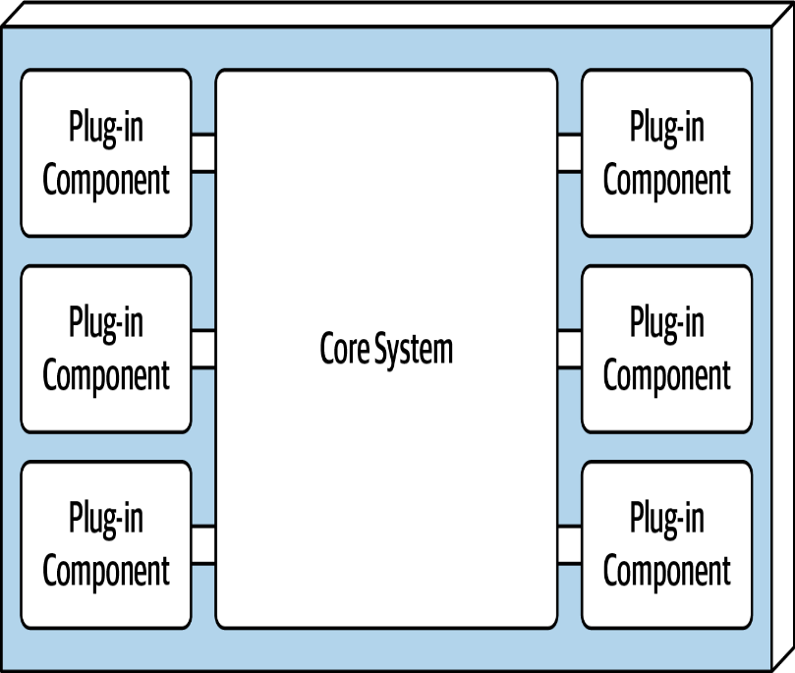
Microkernel
Microkernel architecture style (called plug-in architecture) is monolithic architecture suitable for product-based applications but is widely used in many nonproduct custom business applications as well.
It consists of of two architectural components: a core system and plug-in components.
Application logic is divided between independent plug-in components and the basic core system, providing extensibility, adaptability, and isolation of application features and custom processing logic.
@Dr. Ugrasen Suman, Professor, SCSIT, DAVV Indore (MP), India

Slide 18
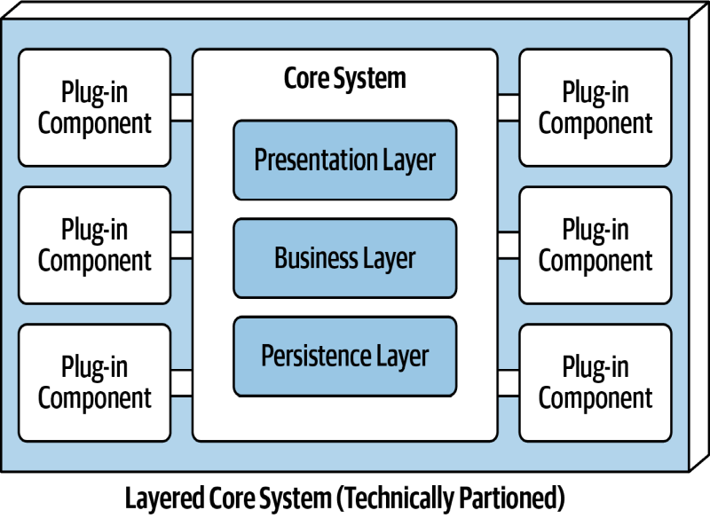
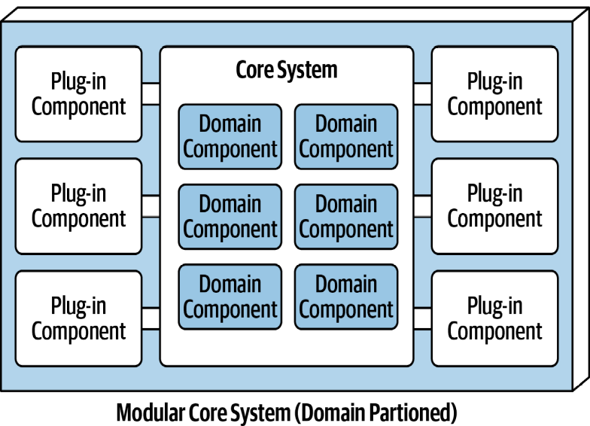
Microkernel
Core System
The core system is formally defined as the minimal functionality required to run the system.
Removing the cyclomatic complexity of the core system and placing it into separate plug-in components allows for better extensibility
and maintainability, as well as increased testability.
Depending on the size and complexity, the core system can be implemented as a layered architecture or a modular monolith.
@Dr. Ugrasen Suman, Professor, SCSIT, DAVV Indore (MP), India

Slide 19
Microkernel
Plug-in Components
Plug-in components are standalone, independent components that contain specialized processing, additional features, and custom code meant to enhance or extend the core system.
They can be used to isolate highly volatile code, creating better maintainability and testability within the application.
The communication between the plug-in components and the core system is generally point-to-point; i.e., plug-in to the core system is usually a method invocation or function call to the entry-point class of the plug-in component.
In addition, the plug-in component can be either compile-based or runtime-based.
Point-to-point plug-in components can be implemented as shared libraries (such as a JAR, DLL, or Gem), package names in Java, or namespaces in C#.
@Dr. Ugrasen Suman, Professor, SCSIT, DAVV Indore (MP), India

Slide 20
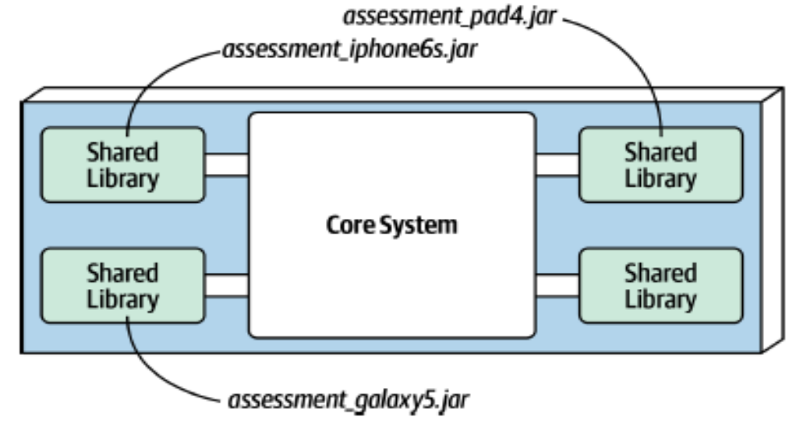
Microkernel
Plug-in Components
@Dr. Ugrasen Suman, Professor, SCSIT, DAVV Indore (MP), India

Slide 21
Client-Server Style
Client-server style is useful for distributed processing, load balancing, separation of concerns, and performance analysis.
In this style, there are two types of components, viz., client and server. And there exists a connecting network between the clients and servers.
The client communicates with servers through protocol and message connectors.
Example: a web browser program running on the Internet has client server style.
The client server architectural style provides higher security, centralized data access, and easier maintenance.
The remote procedure calls (RPC) mechanism is used for requesting and providing services.
@Dr. Ugrasen Suman, Professor, SCSIT, DAVV Indore (MP), India

Slide 22
Client-Server Style
Server
Client 1
Client 2
Client 3
@Dr. Ugrasen Suman, Professor, SCSIT, DAVV Indore (MP), India

Slide 23
Shared Data Style
Shared data style (also known as repository style) comprised of a central data repository (or shared data such as databases, files) and a number of data accessors (like users, nodes, developers) connected to the central repository.
Shared data style creates, stores, updates, and accesses persistent data.
Data accessors access, transform, update, and restore data into the central repository.
There are two major categories of shared data styles, namely, blackboard (i.e. active repository) and traditional database (i.e. passive repository).
@Dr. Ugrasen Suman, Professor, SCSIT, DAVV Indore (MP), India

Slide 24
Shared Data Style
Blackboard (i.e. active repository):
  Any change or update in the repository will be notified to all the data accessors.
  For example, an insurance company policy has a central repository in which any policy change or update is informed to the customers.
Traditional database (i.e. passive repository):
  It provides permanent storage and controls the processing of the applications.
  For example, an inherent symbol table repository of a compiler is used by the phases of compilation as and when required.
@Dr. Ugrasen Suman, Professor, SCSIT, DAVV Indore (MP), India

Slide 25

Blackboard (i.e. active repository)
Data accessor
Central repository
Data accessor
Data accessor
Data accessor
@Dr. Ugrasen Suman, Professor, SCSIT, DAVV Indore (MP), India

Slide 26
Service-Oriented Architecture (SOA)
The service-oriented architecture (SOA) is an architectural paradigm that is used to provide a platform to fulfill the needs of consumers and capabilities of providers to interact through services across different domains and technology.
SOA is essentially a collection of web services, which are well defined, self-contained modules that provide standard business functionality and are independent of the state or context of other web services.
The basic SOA architecture encompasses three roles, namely, web service provider; web service consumer; and Universal Description, Discovery and Integration (UDDI) registry for handling service request, service discovery, and service invocation.
@Dr. Ugrasen Suman, Professor, SCSIT, DAVV Indore (MP), India

Slide 27
Service-Oriented Architecture (SOA)
UDDI registry
Find/retrieve
Register/publish
Web service consumer
Web service provider
Request/response
@Dr. Ugrasen Suman, Professor, SCSIT, DAVV Indore (MP), India

Slide 28
Microservices Architecture
Microservices is heavily inspired by the ideas in domain-driven design (DDD), a logical design process for software projects.
One concept in particular from DDD, bounded context, decidedly inspired microservices.
The concept of bounded context represents a decoupling style.
When a developer defines a domain, that domain includes many entities and behaviors, identified in artifacts such as code and database schemas.
Within a bounded context, the internal parts, such as code and data schemas, are coupled together to produce work; but they are never coupled to anything outside the bounded context, such as a database or class definition from another bounded context.
This allows each context to define only what it needs rather than accommodating other constituents.
@Dr. Ugrasen Suman, Professor, SCSIT, DAVV Indore (MP), India

Slide 29
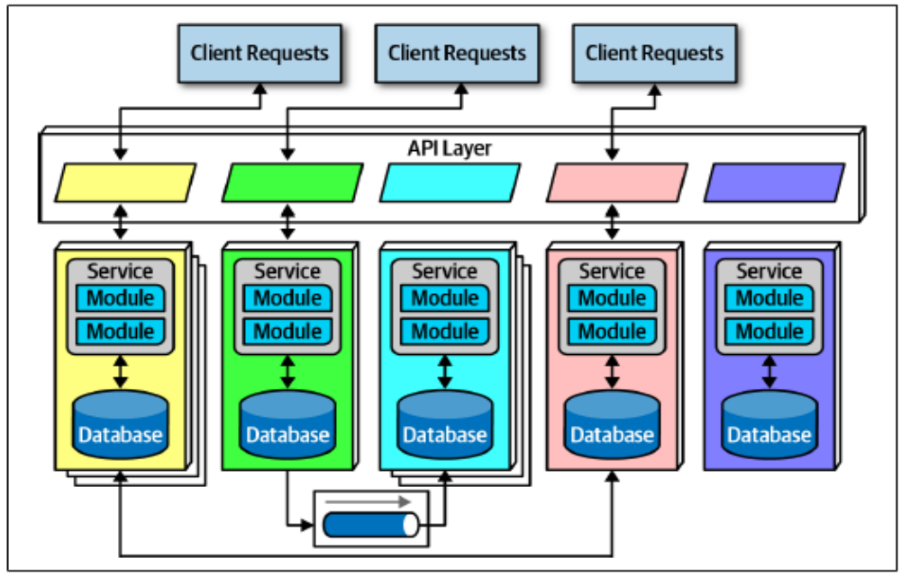
Topology of Microservices architecture style
@Dr. Ugrasen Suman, Professor, SCSIT, DAVV Indore (MP), India

Slide 30
Microservices Architecture
Distributed architecture: each service runs in its own process, which originally implied a physical computer but quickly evolved to virtual machines and containers.
Bounded context: each service models a domain or workflow. Thus, each service includes everything necessary to operate within the application, including classes, other subcomponents, and database schemas.
Granularity: Iteration is performed to ensure good service design.
Data Isolation: microservices tries to avoid all kinds of coupling, including shared schemas and databases used as integration points.
API Layer
Operational Reuse
Frontends
Communication
Choreography and Orchestration
  No central coordinator exists in this architecture
@Dr. Ugrasen Suman, Professor, SCSIT, DAVV Indore (MP), India

